Slide 1

Customer Segmentation
Mini Project 3
Rojesh Dhakal

Slide 2

Dividing wide group of people into smaller group based on their commonalities. Subdividing of a market into distinct subset of a customers
Customer
Segmentation

Slide 3

Importance
Establish our marketing plan.
Concentrate on most profitable customers.
Select the best communication channels.
Develop pricing strategy.
Customer Retention.

Slide 4

If you’re not thinking segments, you’re not thinking. To think segments means you have to think about what drives customers, customer groups, and the choices that are or might be available to them.
-Levitt, Marketing Imagination

Slide 5
Methods Of Customer Segmentation
Demographic
Psychographic
Personality
Interests
Technographic
Email
Device Usage
Behaviour
Purchase behaviour
Decision making style
Value Based
Value Seekers
Economic value
Age
Marital Status
Income
Attitude
Social Media Usage
Marketing Response

Slide 6

How can customer segmentation improve our marketing campaign and increase revenue through increased customer loyalty?
Business Question

Slide 7
Data Pipeline
Data Extraction
Data Preprocessing
Data Analysis
Model Building
Model Summary
Recommendation & Summary

Slide 8
Data Summary
Extracted from Kaggle Supermarket data
2 years of data
2240 rows, 29 columns
Missing Values: Income
26 numerical, 3 categorical

Slide 9
Data Preprocessing
Data Imputation
Outlier Removal
Data formatting
Data Encoding
Standardization

Slide 10

Exploratory Data analysis

Slide 11
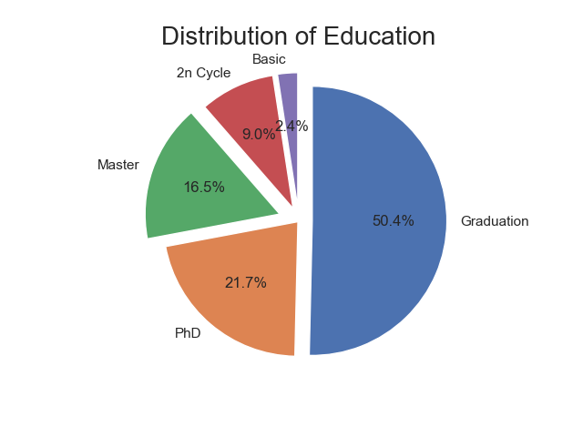
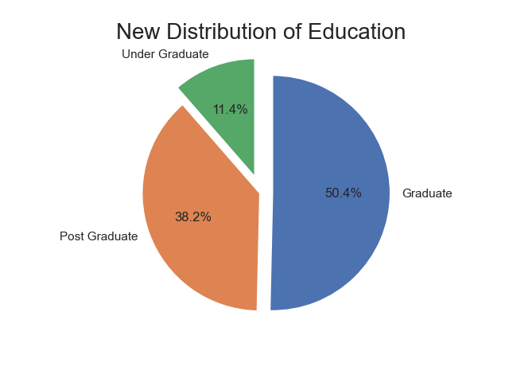
Distribution Of Education
Fig.1
Fig.2
Half of the people are graduate.

Slide 12
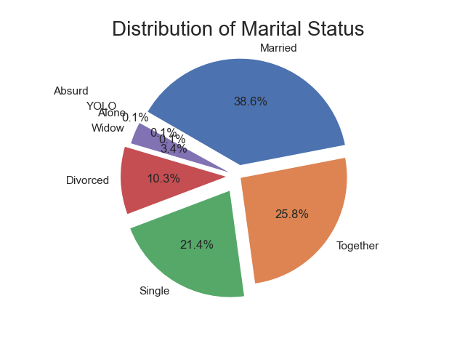
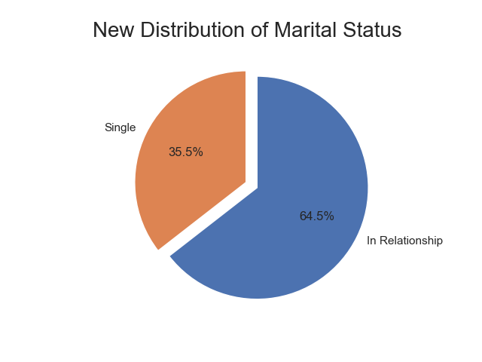
Distribution of Marital Status
Fig.1
Fig.2
Majority are in relationships.

Slide 13
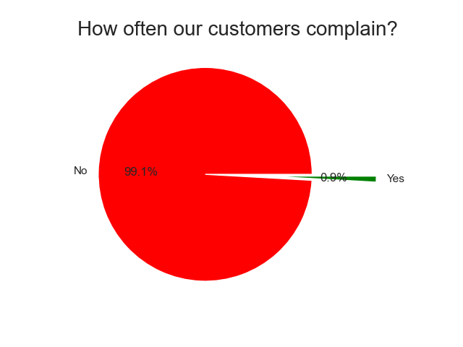
Complain Occurrence

Slide 14

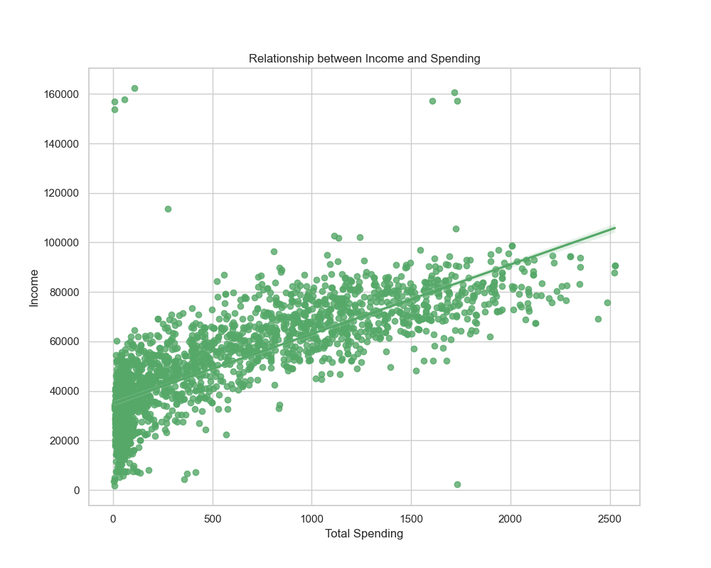
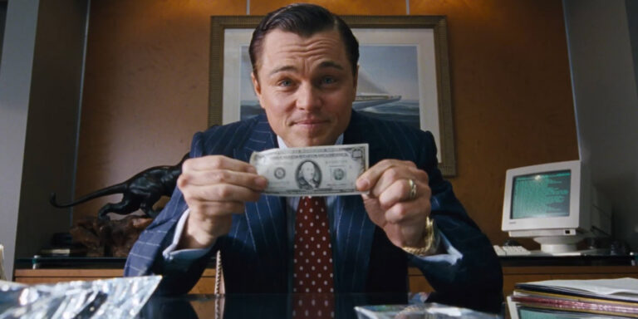
Income Vs Spending

Slide 15
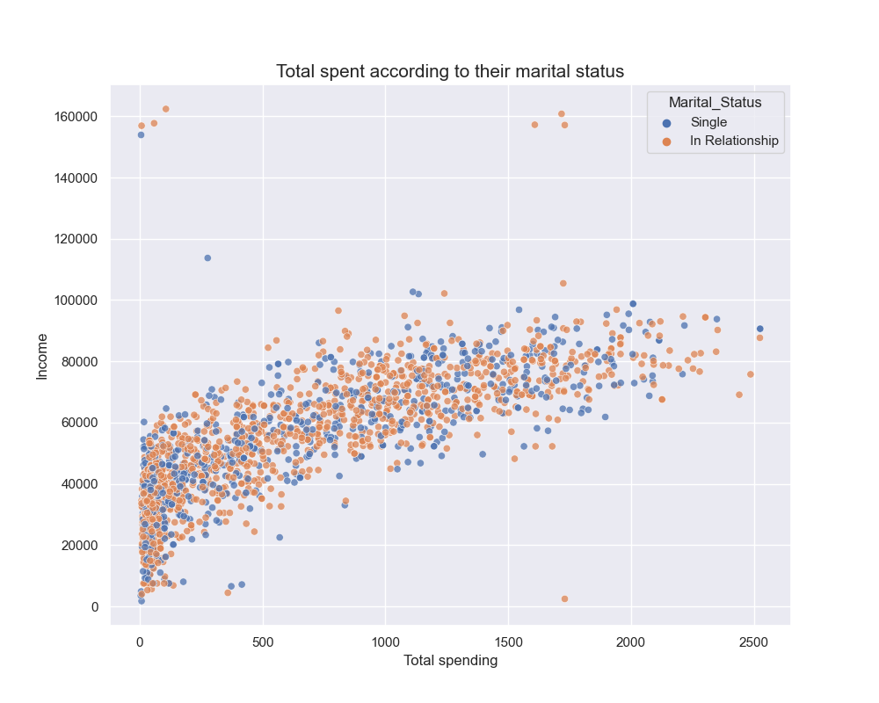
Spending based upon marital status
Similar spending patterns.

Slide 16
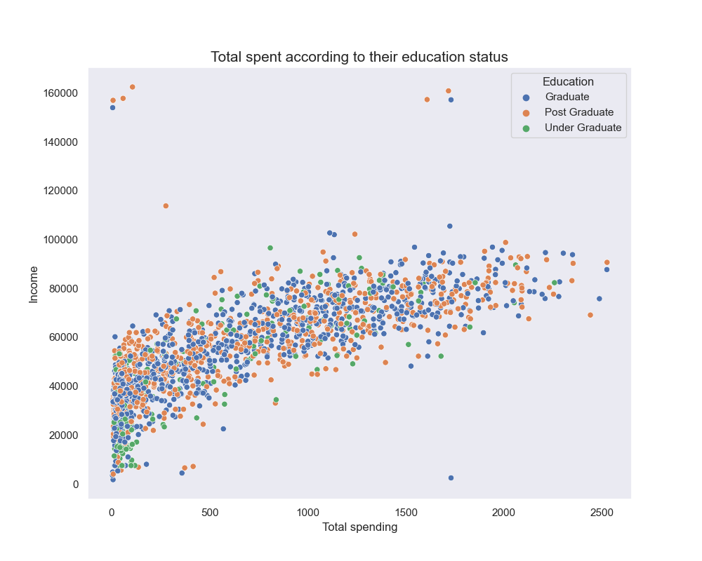
Spending based upon education
Undergraduate earning less and spending less with fewer exception.

Slide 17
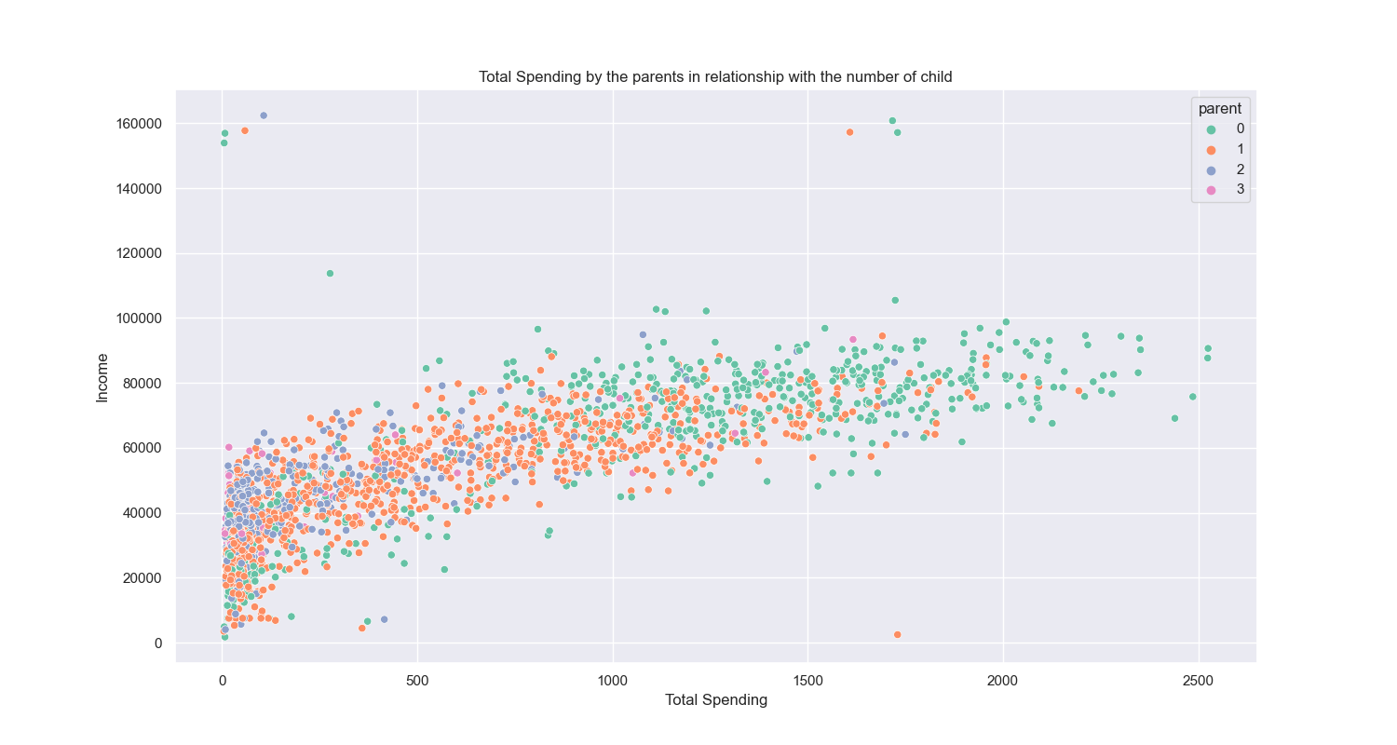
Spending according to Number of children
People with no children are spending more.
Majority has 1 children
Very less people have 3 child.

Slide 18
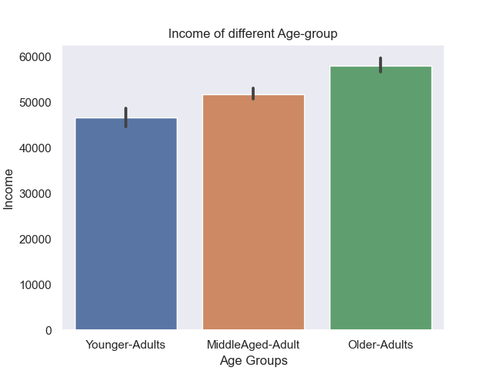
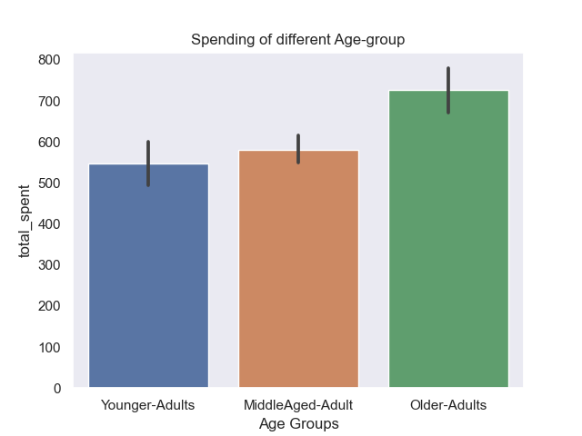
Income and spending by different age groups
Older-Adults earns more and spend more.

Slide 19
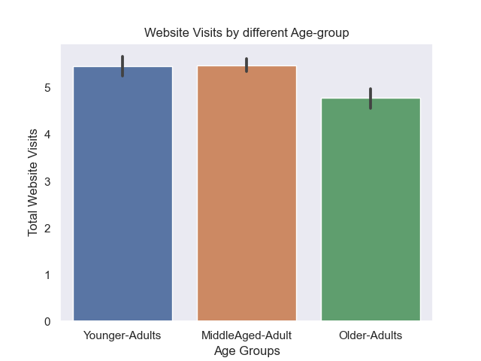
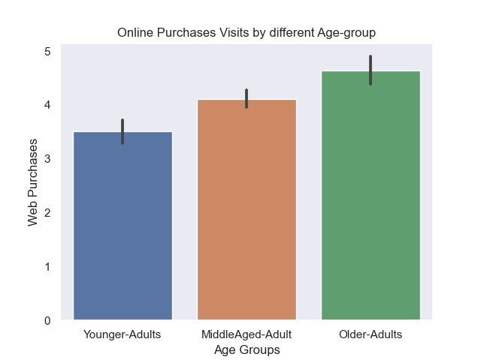
Web visits and purchases by age group
Younger adults visits more to our websites but purchase less compared to others.

Slide 20
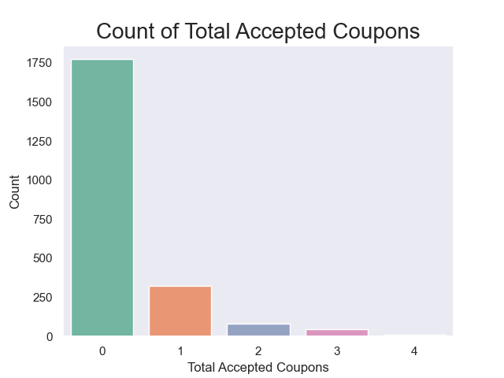
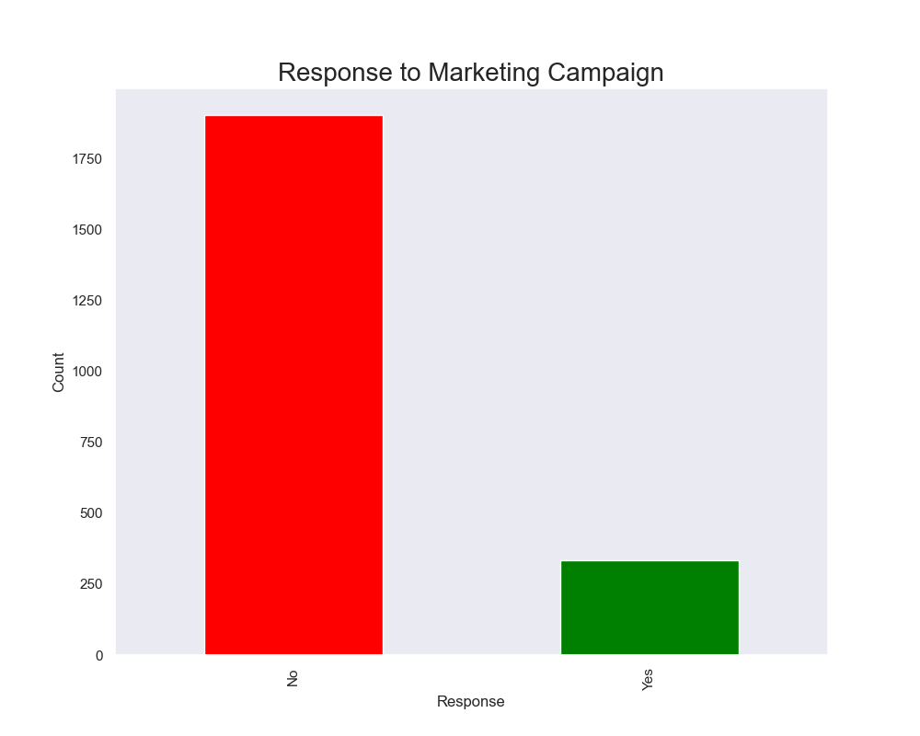
Promotions
(i)
(ii)
Fewer coupons were accepted.
Majority did not respond.

Slide 21
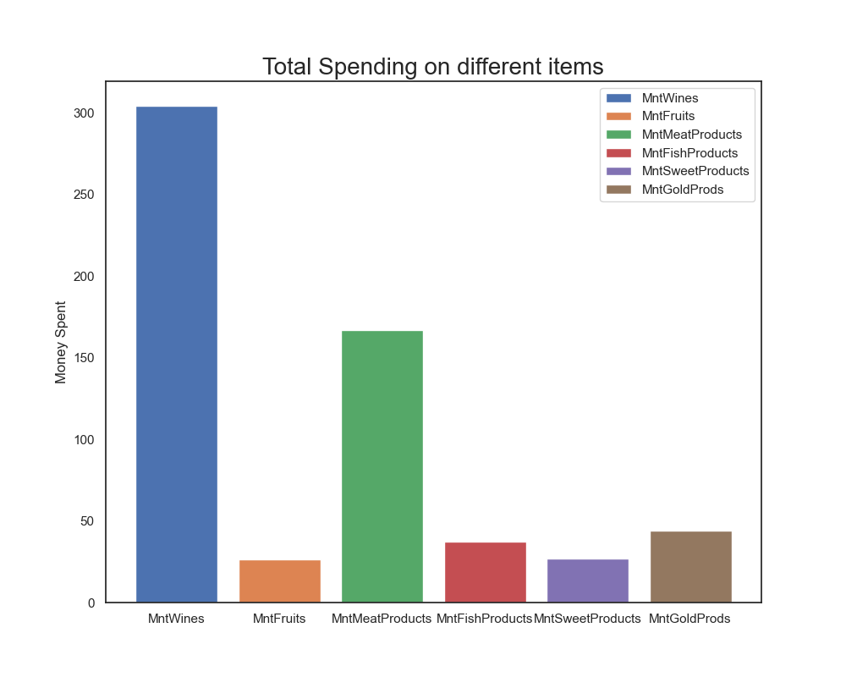
Spending Across different items

Slide 22
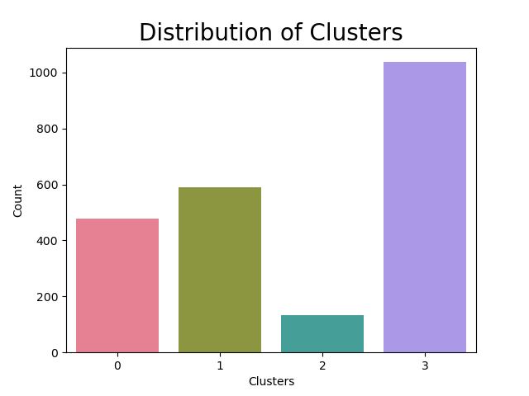
Model Building
PCA
12 features
K-means
4 clusters

Slide 23
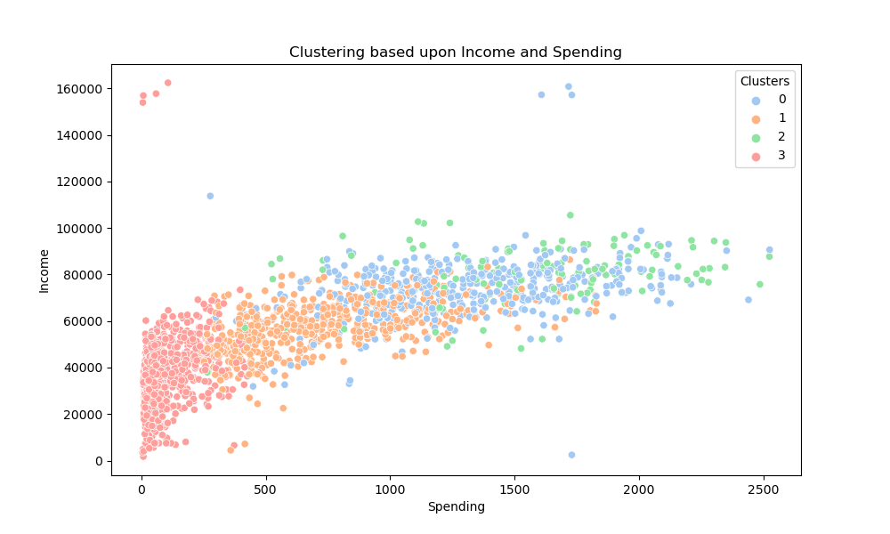
Summary
Clusters Spending and income Analysis
Earning more spending more Cluster 0 and 2 spender
Cluster 3 earns less and spend less but majority.

Slide 24
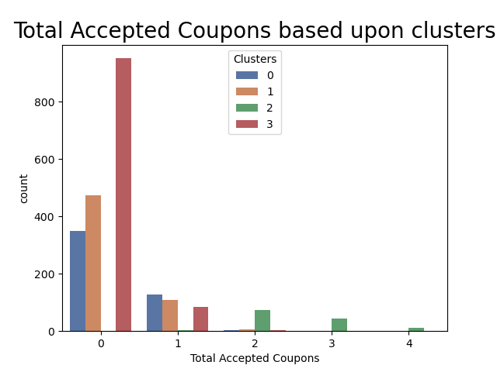
Summary
Coupon acceptance rate
Other than the cluster 2, majority responded to campaign 1 .
Cluster 2 has accepted more campaigns as compared to others

Slide 25
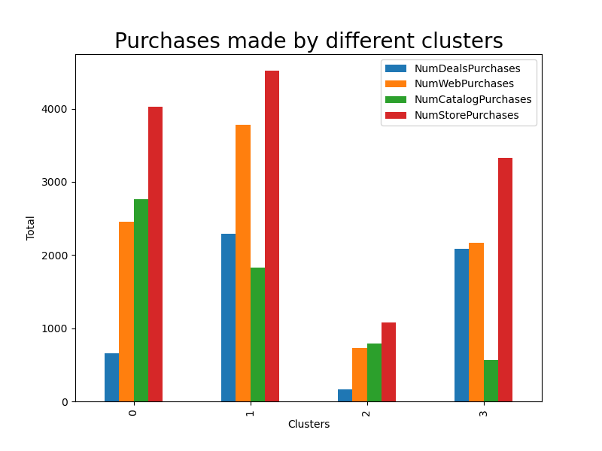
Summary
Purchases done by different clusters
Majority purchases from stores.
Web purchases & Deal purchases highest in Cluster 1

Slide 26
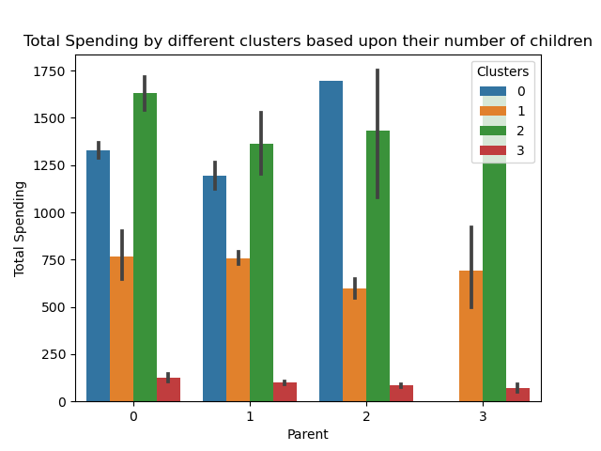
Summary
Spending based upon parents
People having no child are also spending more

Slide 27
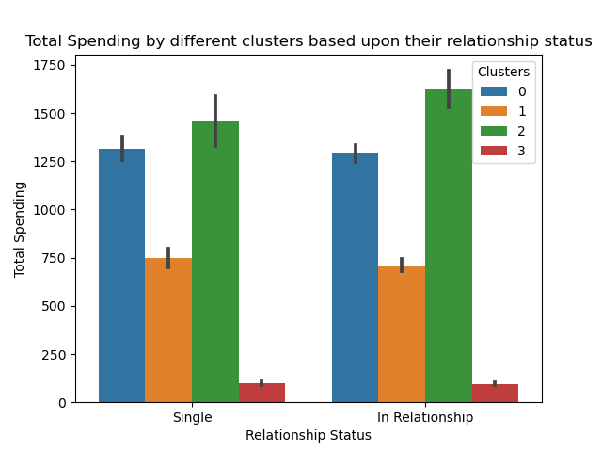
Summary
Spending based upon Relationship status
Similar spending pattern
Cluster 2 spends most

Slide 28
Customer Profiling
Cluster 0
Medium income/ higher spending
Single Individual
Less children
2nd most wine buyer and highest consumer of every other products
Positive response to Campaign 1, but others very bad
Likely to purchase from Catalog
Web purchaser
Cluster 1
Medium income/ Medium spending
Deals
Web purchase
Majority has 1 child
Most Wine buyer
Frequent purchasing from store
Cluster 2
Higher income/higher spending
Minority
Higher response to campaign
Less number of Under Grads
Cluster 3
Lower income/lower spending
Majority
In a relationship
Majority has children
Graduate/Post Grad
Very bad response to campaign
More Complains

Slide 29
Customer Profiling
Cluster 0
Medium income/ higher spending
Single Individual
Less children
2nd most wine buyer and highest consumer of every other products
Positive response to Campaign 1, but others very bad
Likely to purchase from Catalog
Web purchaser
Cluster 1
Medium income/ Medium spending
Deals
Web purchase
Majority has 1 child
Most Wine buyer
Frequent purchasing from store
Cluster 2
Higher income/higher spending
Minority
Higher response to campaign
Less number of Under Grads
Cluster 3
Lower income/lower spending
Majority
In a relationship
Majority has children
Graduate/Post Grad
Very bad response to campaign
More Complains

Slide 30
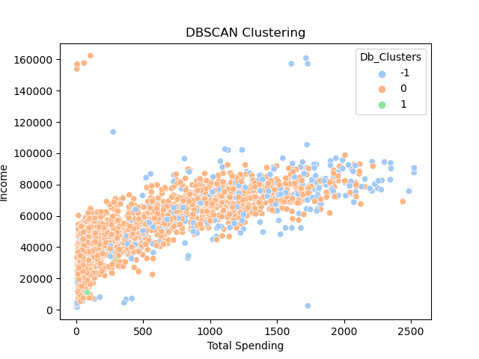
DBSCAN

Slide 31

Conclusion & FUTURE IMPROVEMENTS
Conclusions:
Effective marketing plan mainly targeting for cluster 1. Daily promotions and deals.
Cluster 3 should not be left out because they are majority and price sensitive. More thorough marketing campaign for them. Weekly promotions and deals.
Future Improvements:
Silhouette score
DBSCSAN hyperparameters

Slide 32


